Slide 1
Diafiltration Experiments Elucidate Multi-body Interactions in Complex Feed Streams
Target Journal: Nature – Chemical Engineering, Science
Experimental Results - 7/1/2024

Slide 2
Overarching Questions/Goals for Today
Running Experiments
What data is being collected throughout the course of these experiments?
Data Analysis
How is this data analyzed to constrain the conductivity readings and monitor the concentration of ions in the feed and permeate?
Visualizing the Data/Next Steps
The current equations we have are insufficient in describing ion transport. How will these equations be modified?
Experiments will focus on Na⁺ | Ca²⁺ | La³⁺ separations due to there importance in refining ores and recycling electronics.
Running Experiments | Data Analysis | Visualizing Data and Next Steps

Slide 3
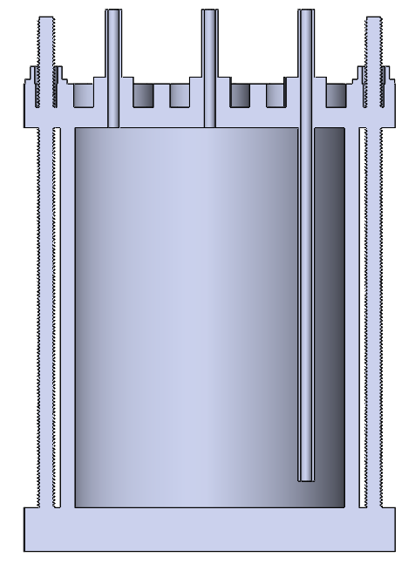
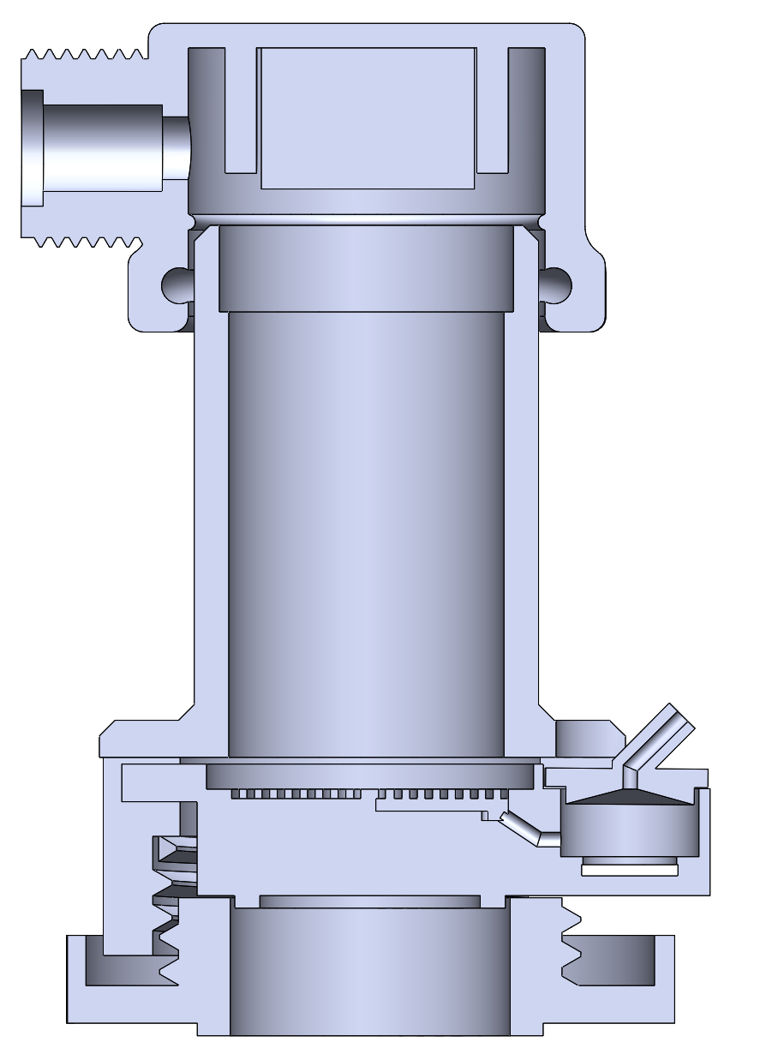
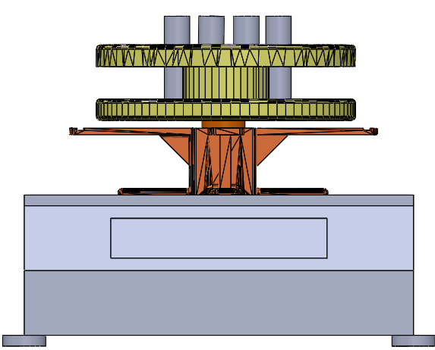

Diafiltration Experiments are Run in a Modified Stirred Cell Apparatus.
Pressure Relief Valve
P
Pressure Gauge
Stirred Cell
Scintillation Vials
Diafiltrate Tank
Permeate Outlet
Motor
Retentate Probe
Balance
Membrane
Permeate Probe
Multiple (two) salts are now placed within the feed and diafiltrate reservoirs.
Retentate and permeate conductivity data are obtained at 5 second intervals.
Scintillation vials are analyzed after the experiment (ICP-OES) to get ion specific concentrations.
Running Experiments | Data Analysis | Visualizing Data and Next Steps

Slide 4
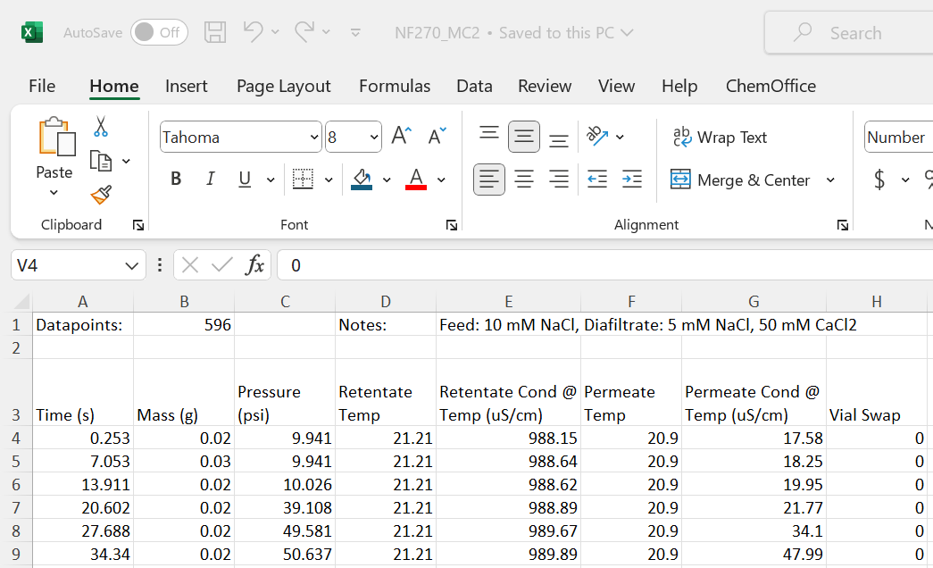
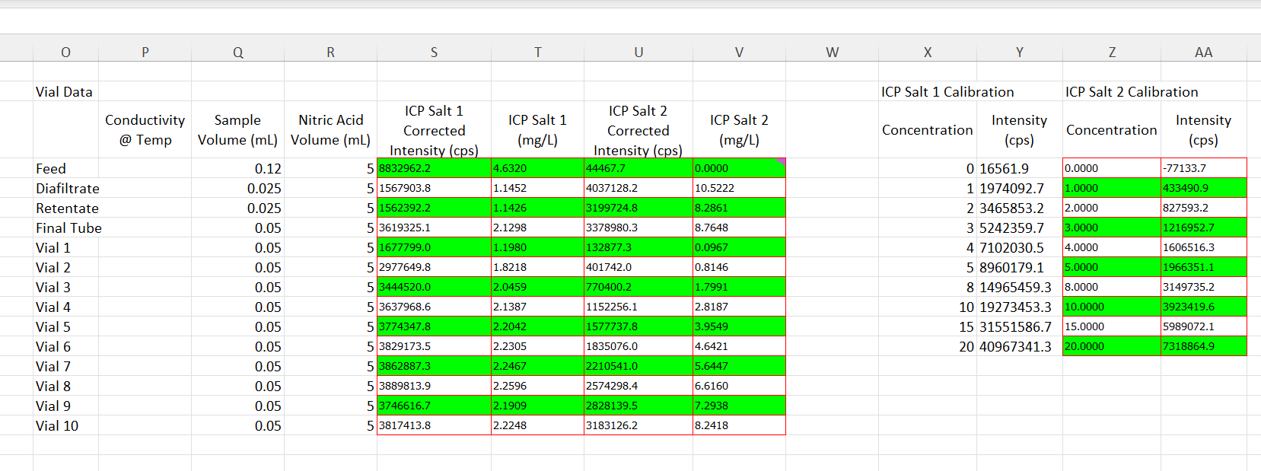
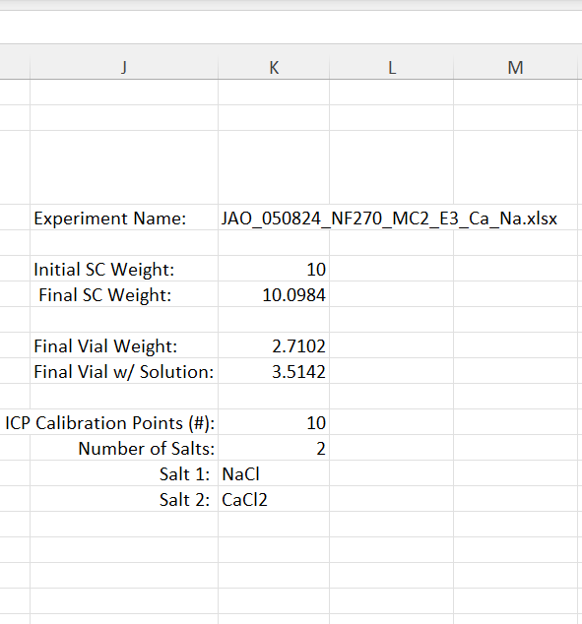
RAW Excel Data will be Included in the Supplementary Information.
Dowling lab: What are the best practices/sources that we can use to make the data sets easily readable/understandable?
Comment/Question on Error: The error associated with the calibration curve is larger than the error associated with the device making the measurement. In the following slides, the analyses incorporate the error of the calibration curve. Error propagation is left for future discussion.
Running Experiments | Data Analysis | Visualizing Data and Next Steps

Slide 5
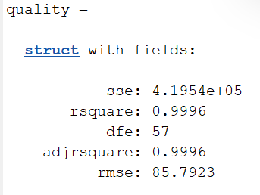
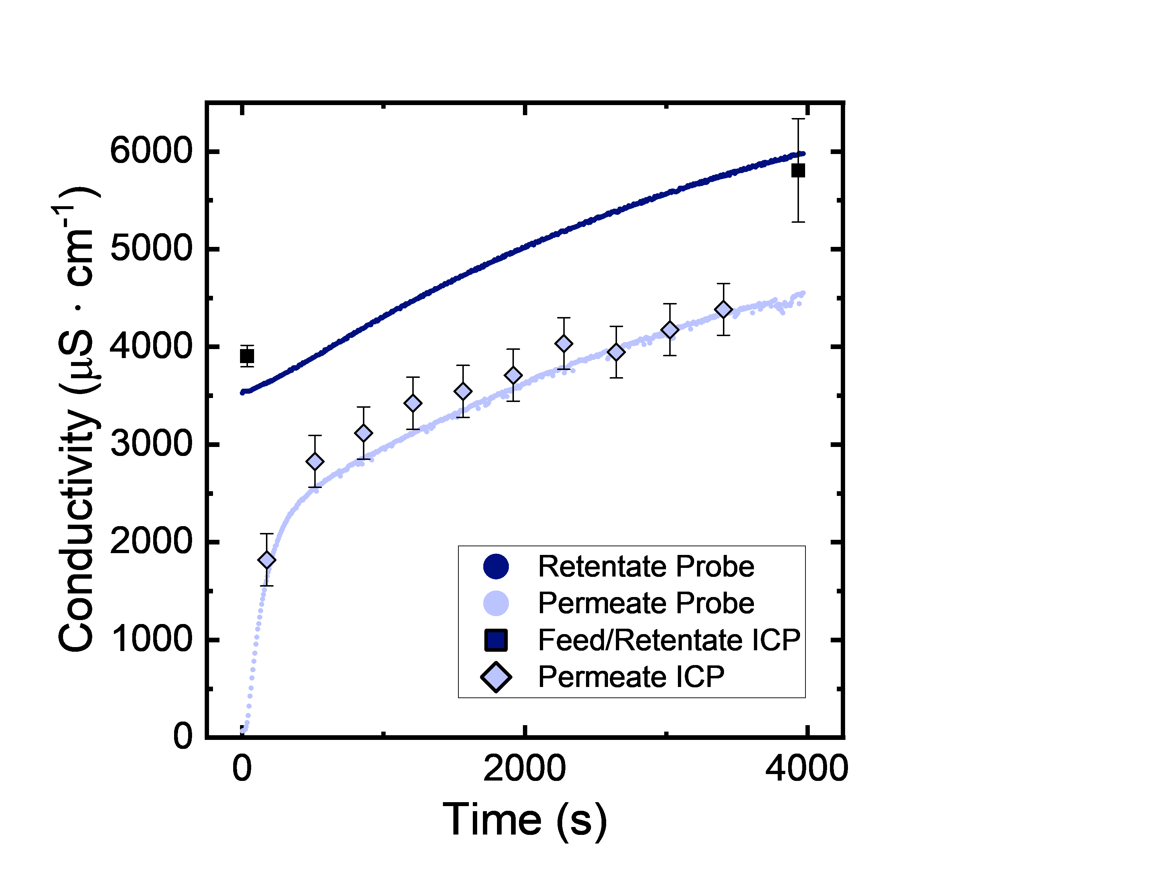
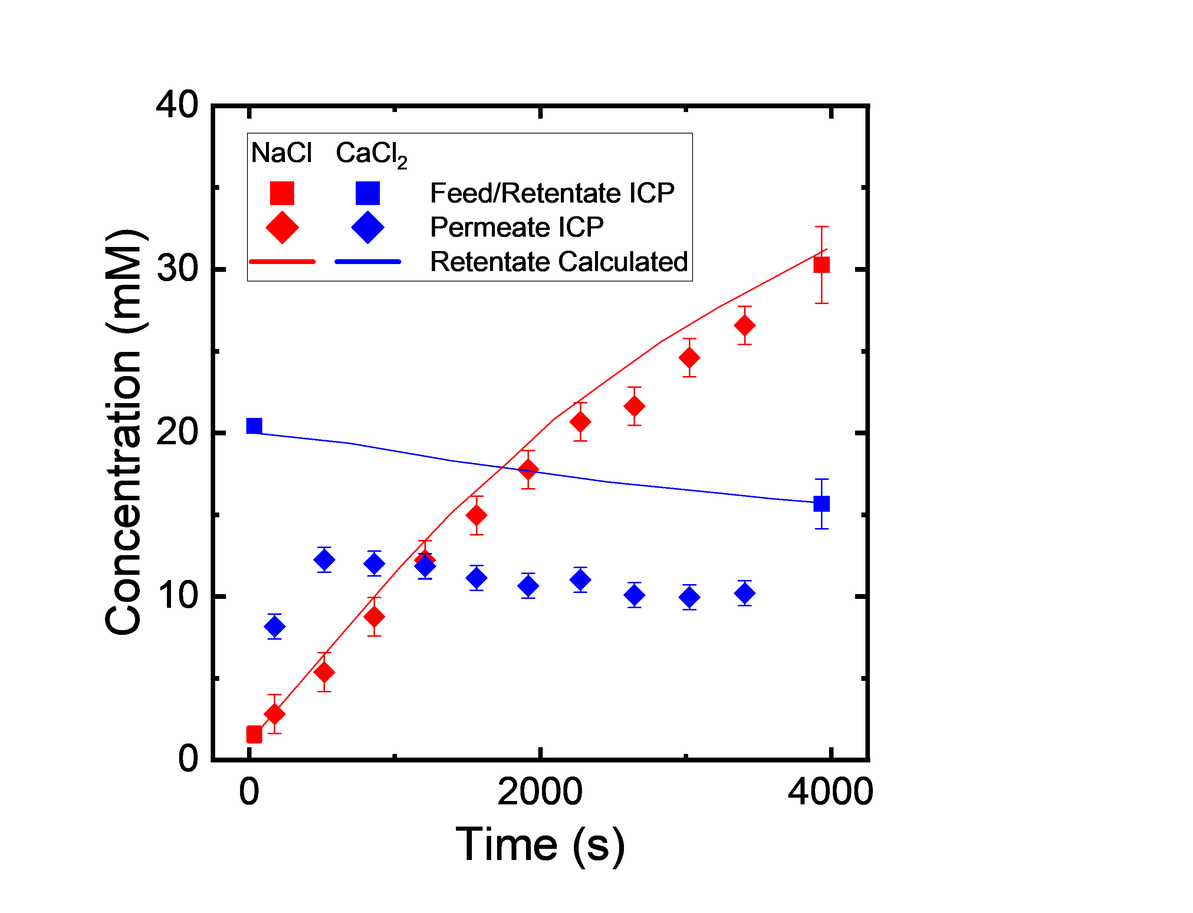
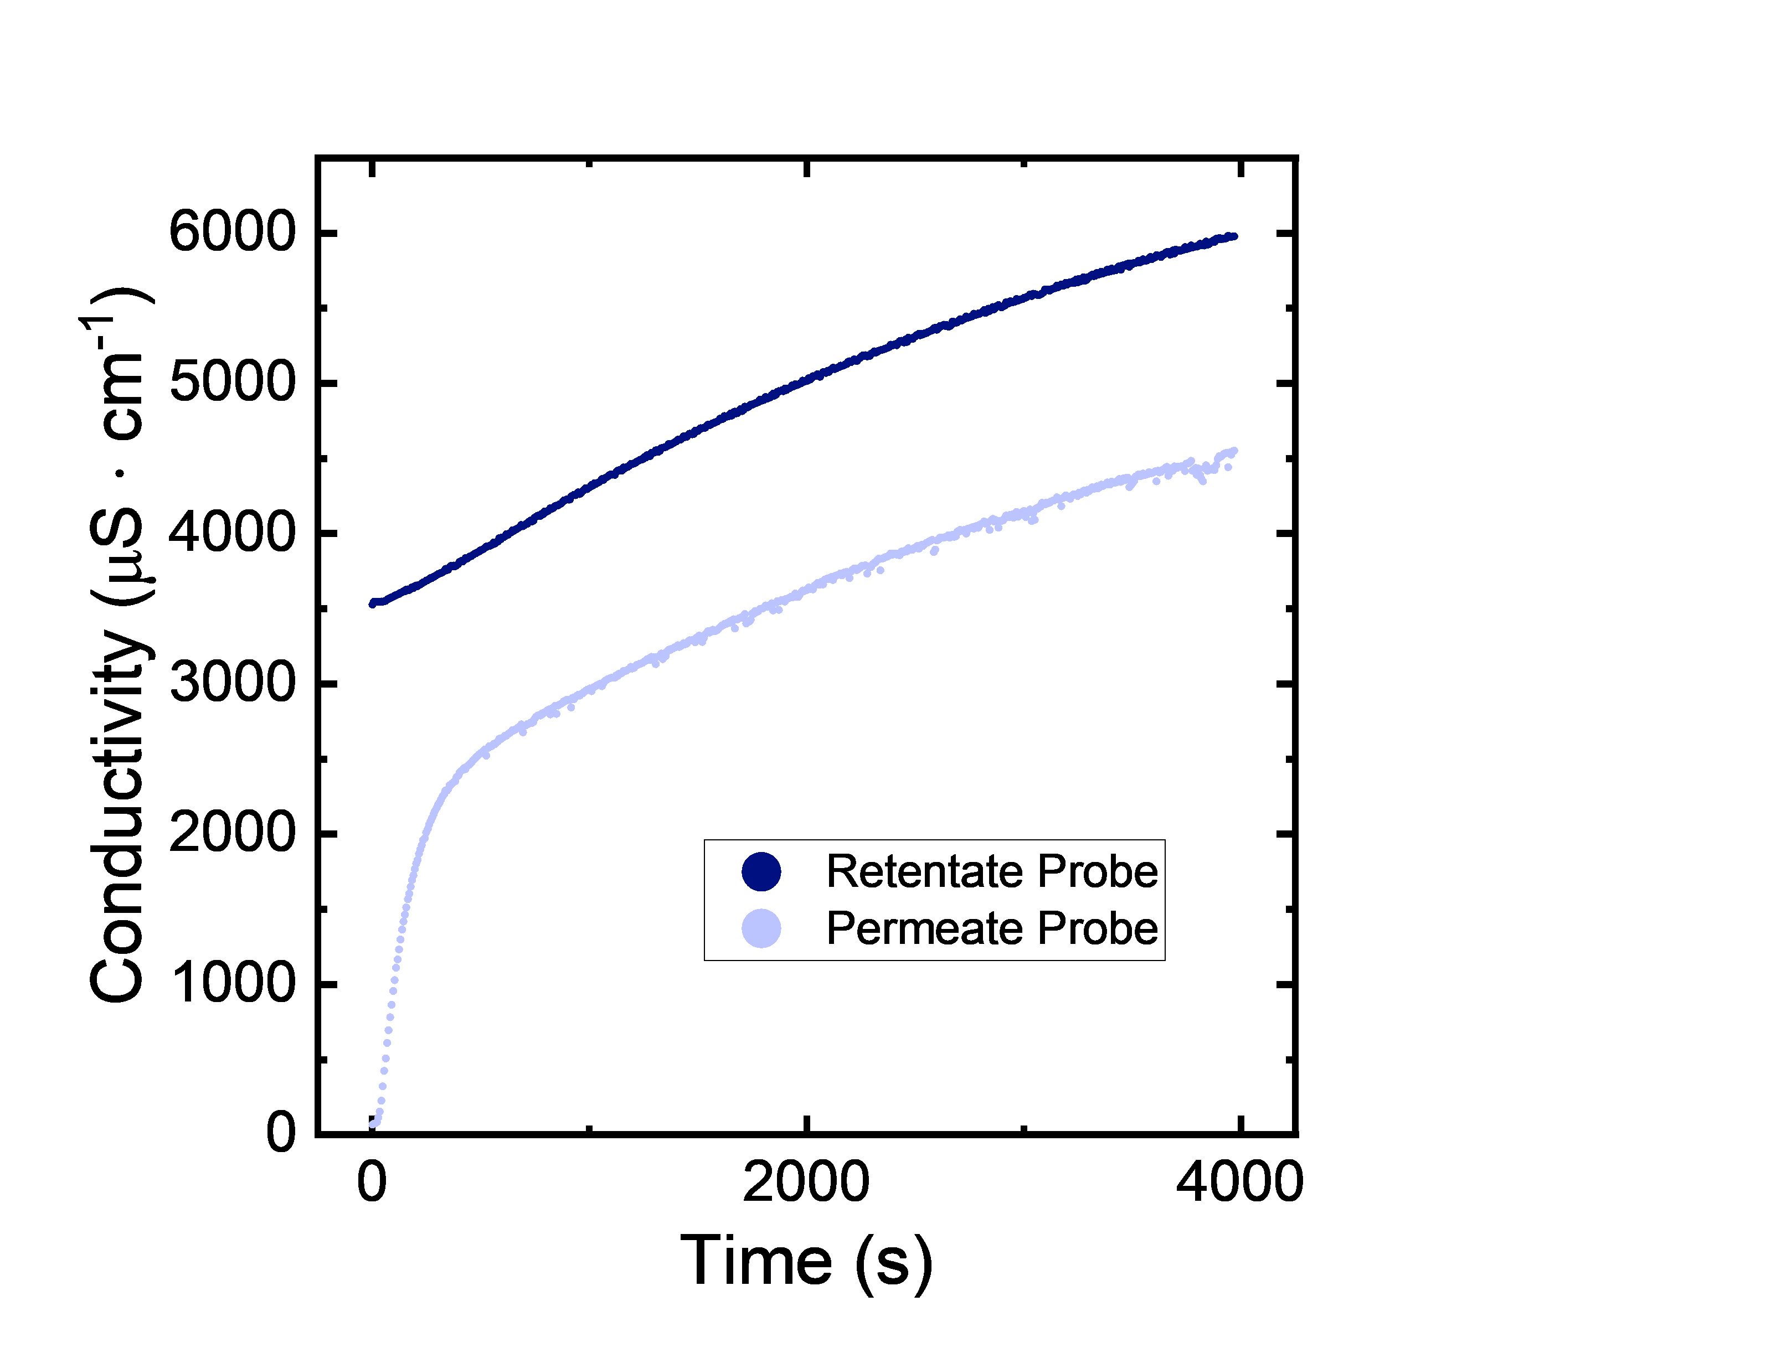
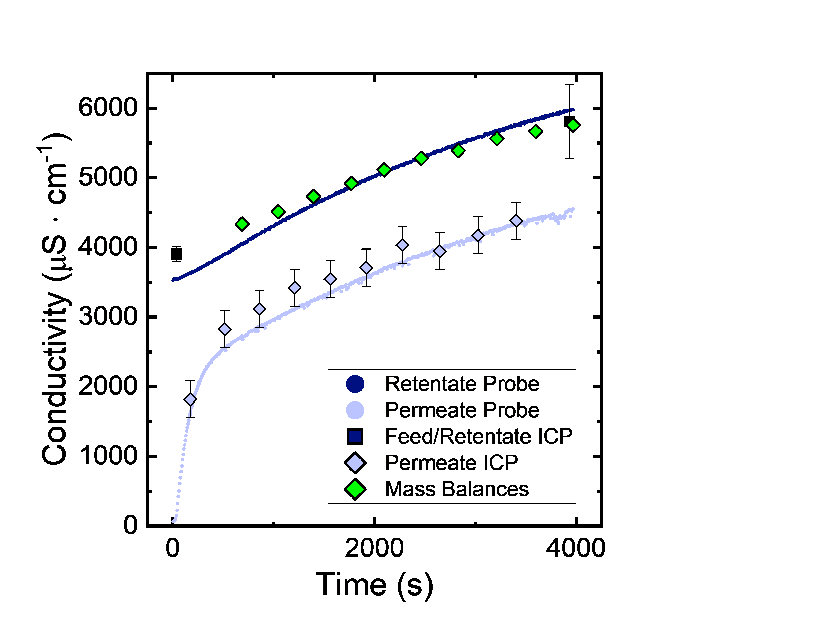
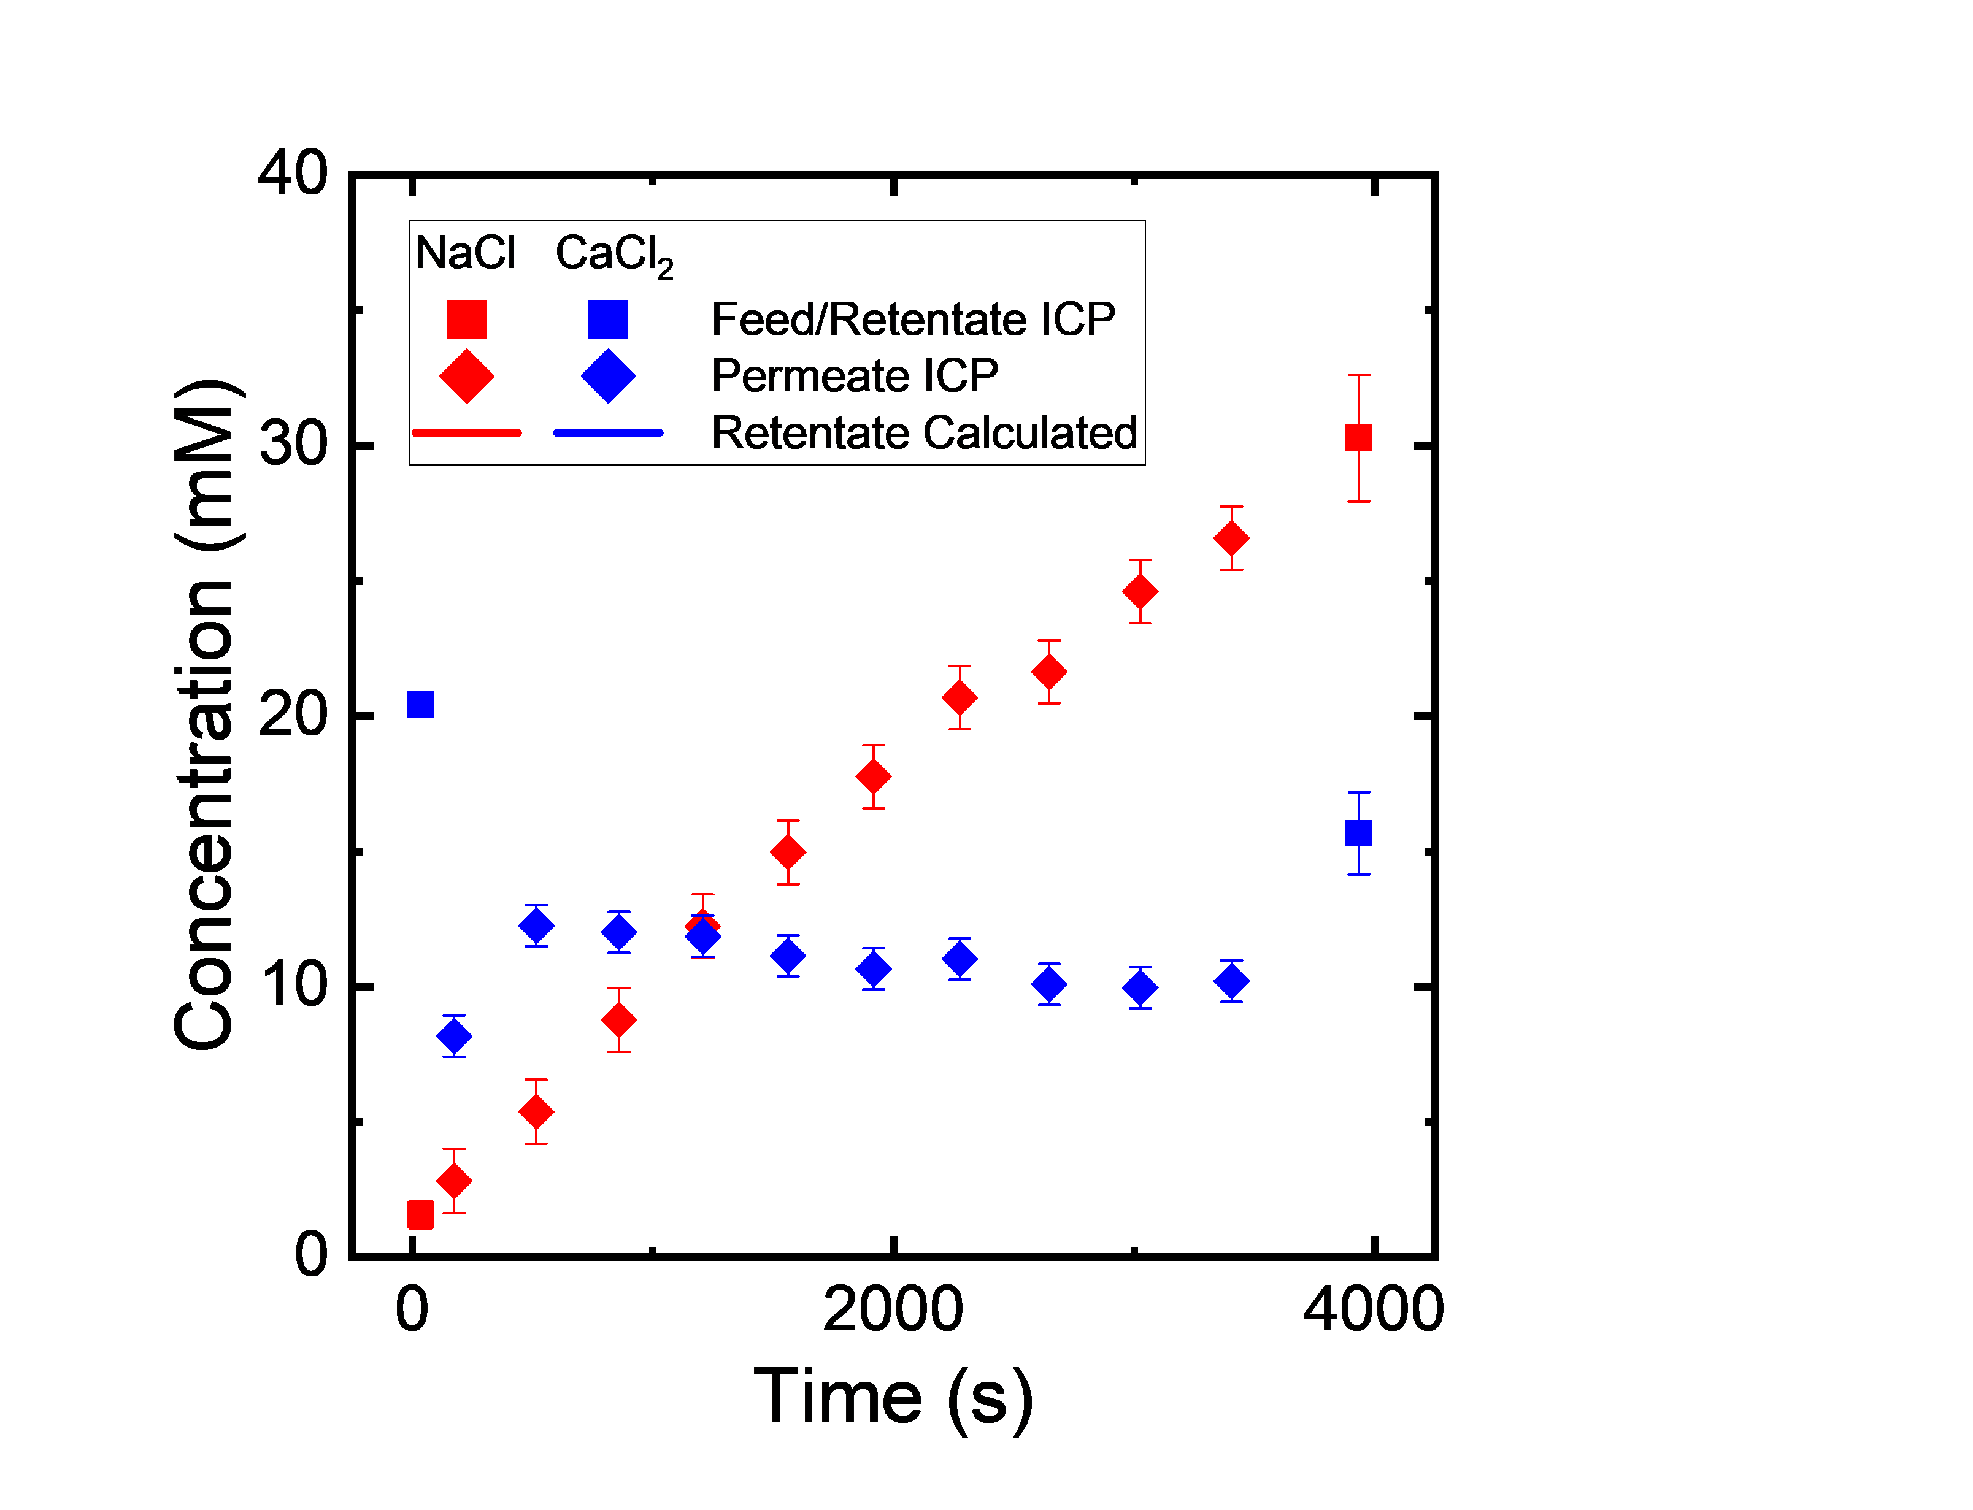
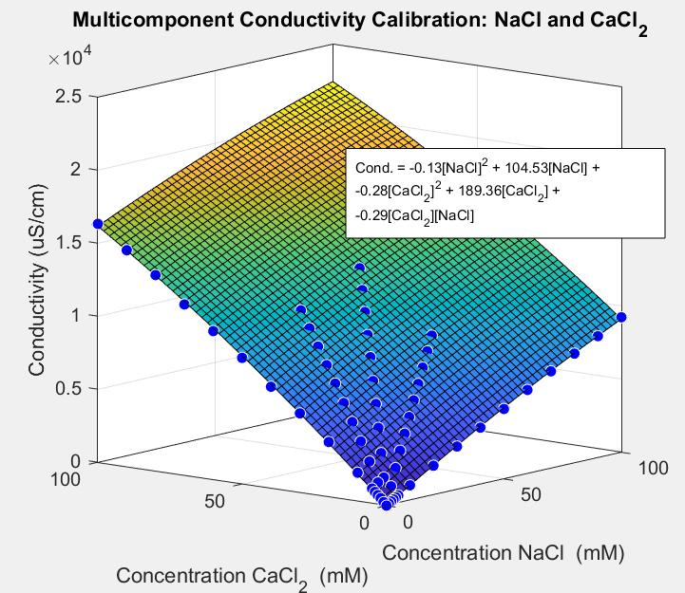
Data Analysis and Visualization
Feed: 20 mM NaCl
Diafiltrate: 10 mM NaCl, 50 mM CaCl₂
Running Experiments | Data Analysis | Visualizing Data and Next Steps

Slide 6
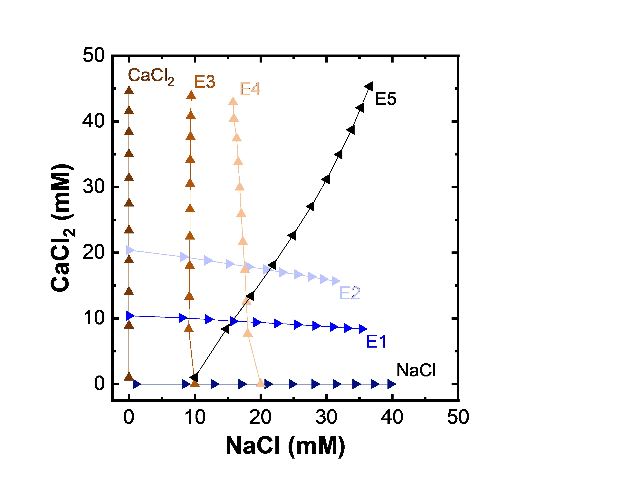
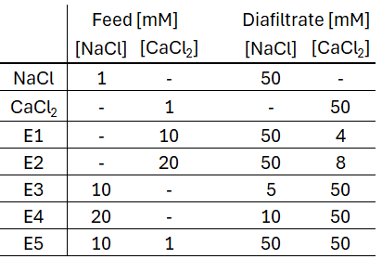
Diafiltration Experiments Systematically Explore Multi-component Feeds
The data plots the retentate concentrations that were explored throughout the course of the experiments.
Compare the final concentrations in experiment group (1) CaCl₂, E3, E4 and (2) NaCl, E1, E2
Running Experiments | Data Analysis | Visualizing Data and Next Steps

Slide 7
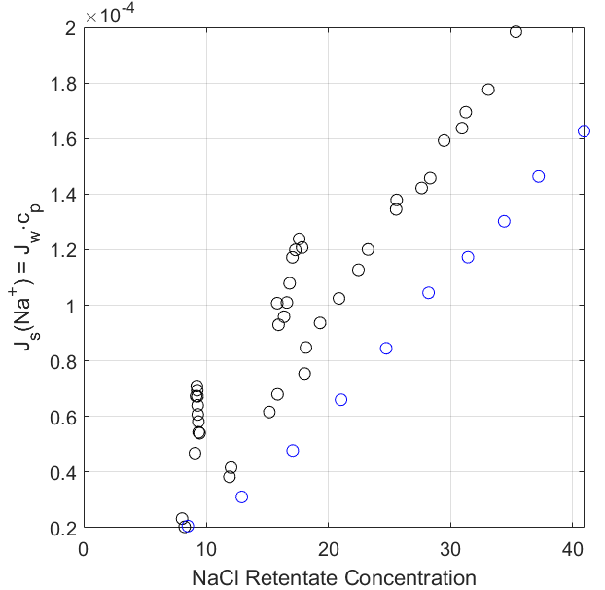
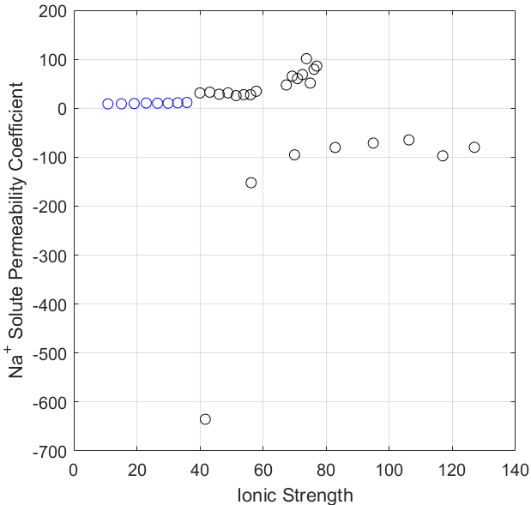
The Presence of Divalent Ions Enhance the Flux of Monovalent Ions
Constant Ca²⁺, Increasing NaCl
Calculation of B Assumes Diffusion Only
Constant Na⁺, Increasing Ca²⁺
Multicomponent Ca, Na
Single component, Na
Increasing [Ca²⁺]
Deriving New Equations
Concentration polarization – Accounts for diffusion and convection. Need to modify for electromigration.
Flux through membrane – Possess equations for diffusion/convection. Need to modify for electromigration.
Running Experiments | Data Analysis | Visualizing Data and Next Steps

Slide 8
Next Steps
Theory
Derivation of equations to incorporate electromigration
Nernst Plank (Flux through membrane)
Concentration Polarization (Interface Conc.)
Derivation of Donnan Equilibrium for multivalent species
We know Donnan alone will not capture the transport of salts, we are developing the equations that illustrate this mathematically.
Experimental
Execution of Ca²⁺ | La³⁺ and Na⁺ | La³⁺ experiments
Duplicate experiments
Revised analysis with ‘correct’ concentration polarization.
Design of trivalent ion experiment (will be motivated by the ratio/concentrations of industrially relevant feed streams)
Running Experiments | Data Analysis | Visualizing Data and Next Steps

Slide 9
Supplementary Slides

Slide 10
Data Sets – NaCl, CaCl2 – Estimated Dates
Membrane #1 – Completed
Membrane #2 – Need duplicate samples
5/6/24 (Single Component)
Exp #1. Feed: 1 mM NaCl; Diafiltrate: 50 mM NaCl
Exp #2. Feed: 1 mM CaCl2; Diafiltrate: 50 mM CaCl2
5/7/24 (Multicomponent – constant NaCl)
Exp #3. Feed: 10 mM NaCl, 0 mM CaCl2; Diafiltrate: 5 mM NaCl, 50 mM CaCl2
Exp #4. Feed: 20 mM NaCl, 0 mM CaCl2; Diafiltrate: 10 mM NaCl, 50 mM CaCl2
5/8/24 (Multicomponent – constant CaCl2)
Exp #5. Feed: 0 mM NaCl, 10 mM CaCl2; Diafiltrate: 50 mM NaCl, 4 mM CaCl2
Exp #6. Feed: 0 mM NaCl, 20 mM CaCl2; Diafiltrate: 50 mM NaCl, 8 mM CaCl2
5/9/24
Exp #7. Feed: 10 mM NaCl, 1 mM CaCl2; Diafiltrate: 50 mM NaCl, 50 mM CaCl2

Slide 11
Data Sets – CaCl2, LaCl3 – Estimated Dates
Membrane #1 – Need to run – Week of 5/20/24
Membrane #2 – Need duplicate samples
5/21/24: Single Component
Exp #1. Feed: 1 mM LaCl3; Diafiltrate: 20 mM LaCl3 → (~100% rejection, ∆π ~29psi)
5/22/24: Multicomponent – constant LaCl3 - assume ~96% LaCl3 rejection, ~50% CaCl2 rejection
Exp #2. Feed: 5 mM LaCl3, 0 mM CaCl2; Diafiltrate: 0.2 mM LaCl3, 50 mM CaCl2 → max ∆π ~34 psi
Exp #3. Feed: 10 mM LaCl3, 0 mM CaCl2; Diafiltrate: 0.4 mM LaCl3, 50 mM CaCl2 → max ∆π ~41.3 psi
5/23/24: Multicomponent – constant CaCl2 - assume ~96% LaCl3 rejection, ~50% CaCl2 rejection
Exp #4. Feed: 0 mM LaCl3, 10 mM CaCl2; Diafiltrate: 15 mM LaCl3, 6 mM CaCl2 → max ∆π ~ 30 psi
Exp #5. Feed: 0 mM LaCl3, 20 mM CaCl2; Diafiltrate: 15 mM LaCl3, 12 mM CaCl2→ max ∆π ~ 40 psi
5/24/24
Exp #6. Feed: 1 mM LaCl3, 5 mM CaCl2; Diafiltrate: 10 mM LaCl3, 25 mM CaCl2 → max ∆π ~ 40 psi
Two things after this set of experiments.
Run duplicates ( ~ 2 weeks to run)
Run NaCl, LaCl3 experiments – If you want me to run these, tell Laurianne that she has until the 29th of I run it.

Slide 12
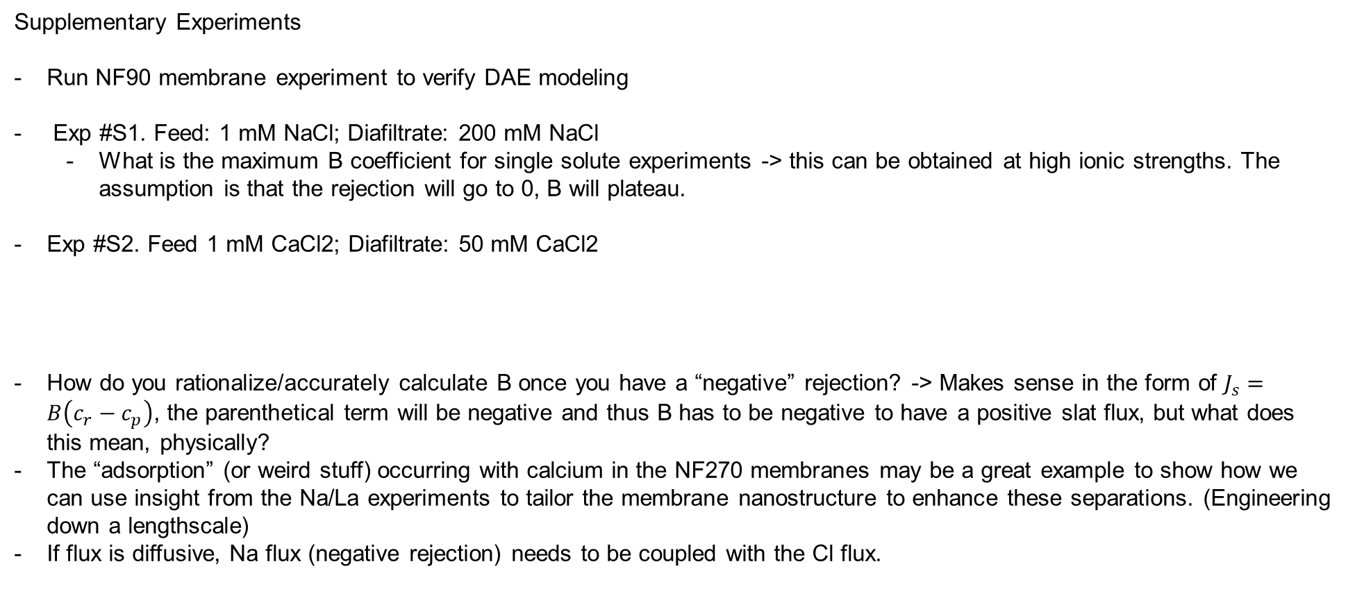
Data Sets – MC2
Supplementary Experiments
Run NF90 membrane experiment to verify DAE modeling
Exp #S1. Feed: 1 mM NaCl; Diafiltrate: 200 mM NaCl
What is the maximum B coefficient for single solute experiments -> this can be obtained at high ionic strengths. The assumption is that the rejection will go to 0, B will plateau.
Exp #S2. Feed 1 mM CaCl2; Diafiltrate: 50 mM CaCl2
How do you rationalize/accurately calculate B once you have a “negative” rejection? -> Makes sense in the form of $J_{s}=B\left(c_{r}−c_{p}\right)$, the parenthetical term will be negative and thus B has to be negative to have a positive slat flux, but what does this mean, physically?
The “adsorption” (or weird stuff) occurring with calcium in the NF270 membranes may be a great example to show how we can use insight from the Na/La experiments to tailor the membrane nanostructure to enhance these separations. (Engineering down a lengthscale)
If flux is diffusive, Na flux (negative rejection) needs to be coupled with the Cl flux.

Slide 13
Manuscript Figures

Slide 14
NF270_MC2, E2. Feed: 20 mM CaCl₂, Diafiltrate: 8 mM CaCl₂, 50 mM NaCl
Edits to figure.
Right panel: The current shapes are too similar – suggest having unfilled/half filled diamonds.
Left panel: The green diamonds are ‘confusing’. These are predictions, they should be a line.
SI Table with all the experiments – operating conditions, feed and diafiltrate concentrations, etc.
SI Figures for all experiments conducted to visualize/verify agreement between multiple types of data: Total of 15 – 20 sets of figures. (Duplicate experiments will not have figures)

Slide 15
Edits to figure. 3 panel figure. Phase space explored by multicomponent diafiltration experiments.
Instead of lines, we should overlay ‘circular’ data points that correspond to the calculated retentate concentrations.
Keep the triangles that provide information on the “path” of the experiment with respect to time.
There is likely a figure similar to this for the ternary system. – Will also need to present and validate the raw experimental data.

Slide 16
Edits to figure.
There is a figure/panel of figures that examines the interface concentration as a function of ionic strength.
A discussion on how

Slide 17
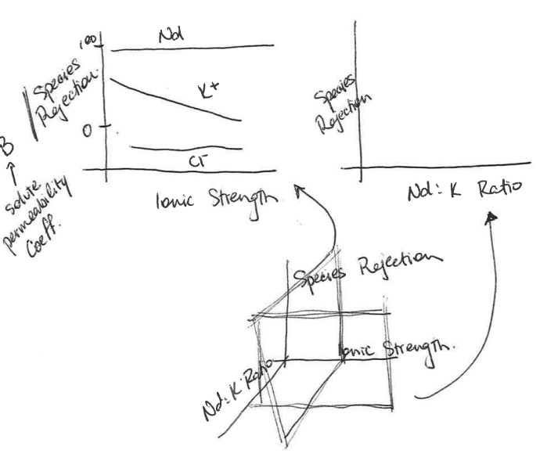
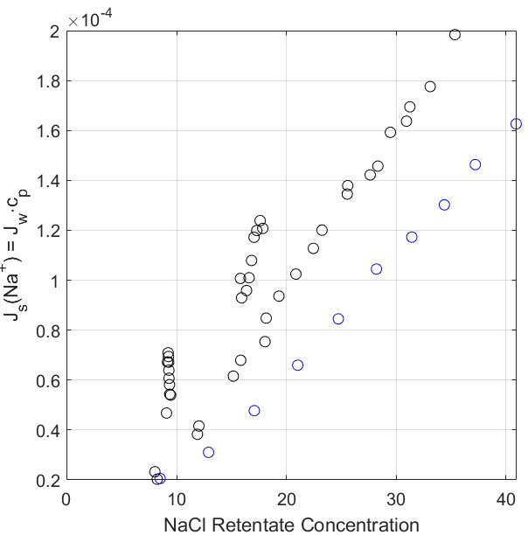
Edits to figure.
This figure is 2D, but I think there is a 3D equivalent that examines solute flux as a function of retentate concentration
There are likely two panels – one of the panels will have solute flux as a function of the interface concentration
Prediction that the data will collapse when you graph against the interface concentration.
3 panel figure. Phase space explored by multicomponent diafiltration experiments.

Slide 18
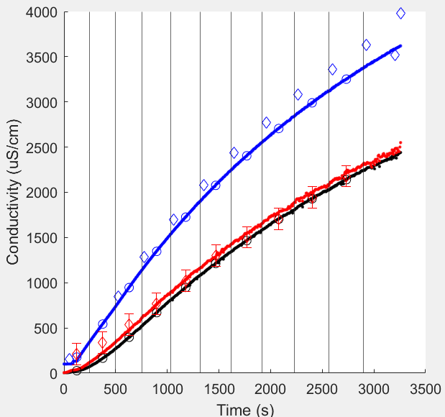
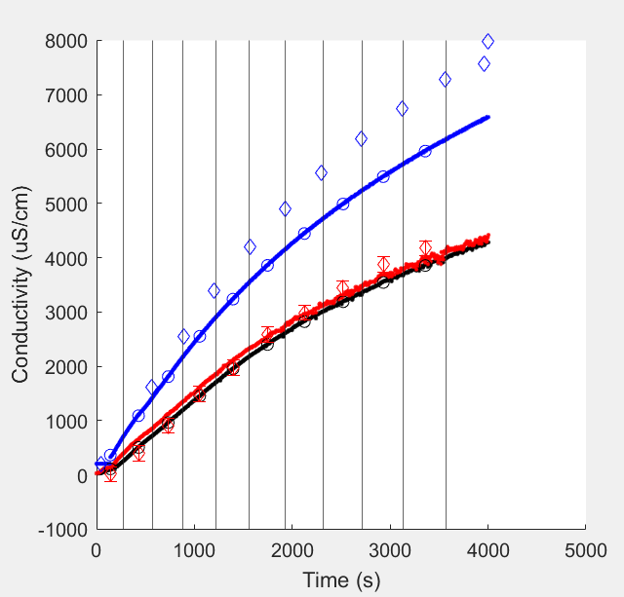
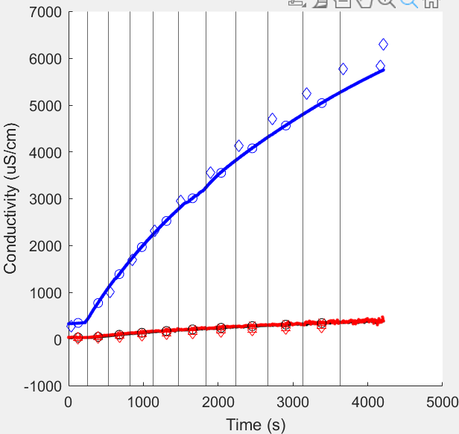
CaCl2 – Single Component
LaCl3 – Single Component

Slide 19
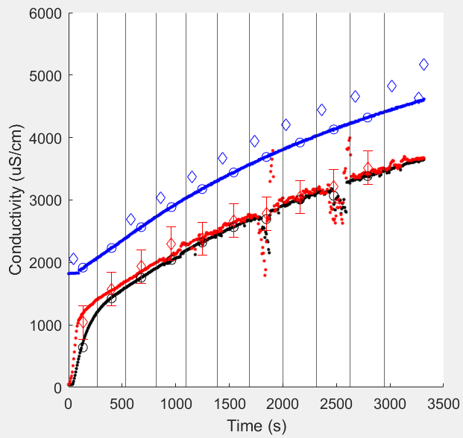
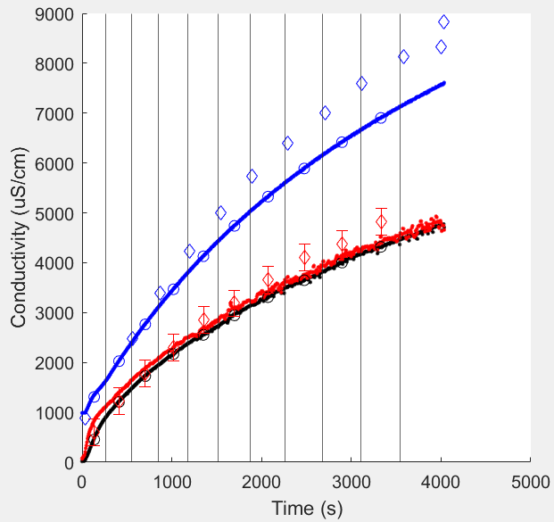
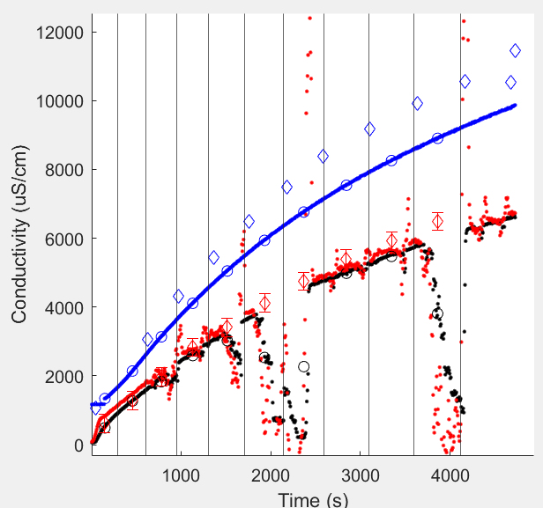
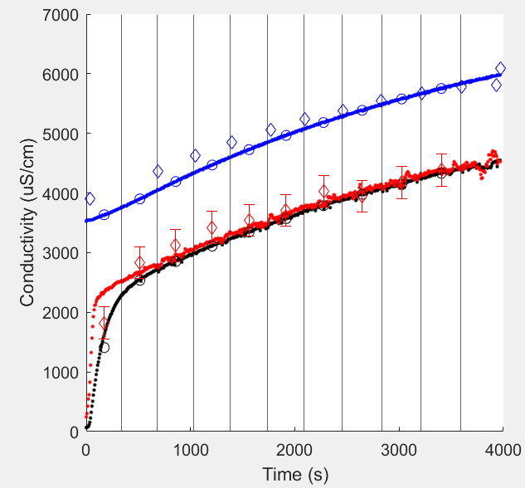
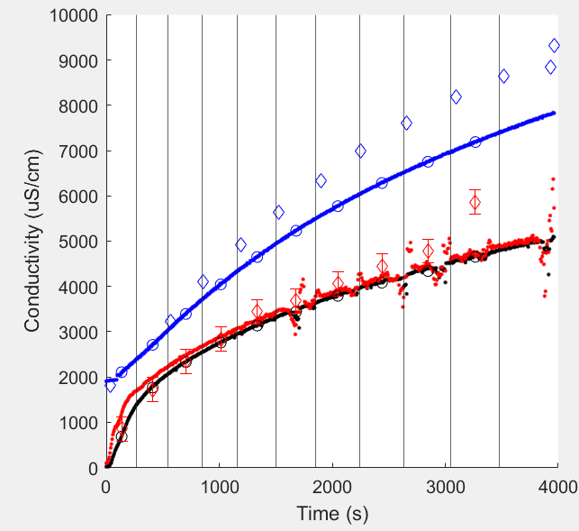
E1.
Feed: 10 mM CaCl2
Diafiltrate: 50 mM NaCl, 4 mM CaCl2
E3.
Feed: 10 mM NaCl
Diafiltrate: 50 mM CaCl2, 5 mM NaCl
E5.
Feed: 10 mM NaCl, 1 mM CaCl2
Diafiltrate: 50 mM CaCl2, 50 mM NaCl
E2.
Feed: 20 mM CaCl2
Diafiltrate: 50 mM NaCl, 8 mM CaCl2
E4.
Feed: 20 mM NaCl
Diafiltrate: 50 mM CaCl2, 10 mM NaCl
NaCl – CaCl2 Multicomponent

